Slide 1


Packer
https://www.packer.io
Kumar
https://www.packer.io/

Slide 2
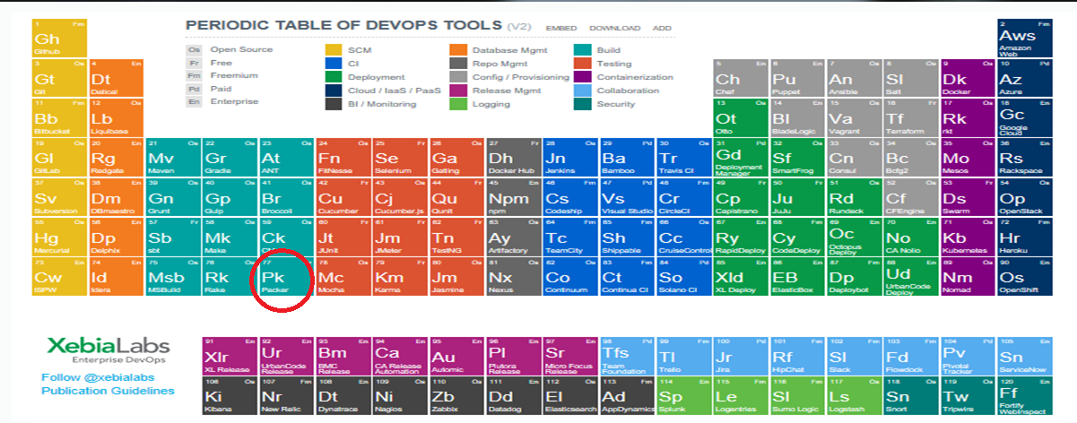
Packer in XebiaLabs

Slide 3
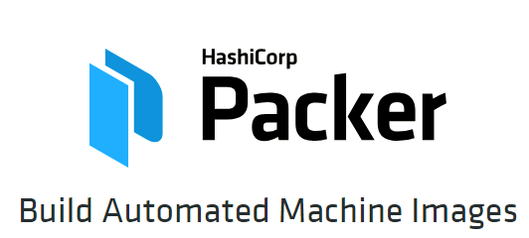
About Packer
Notes:
Hello and welcome to this course, Hands-on Packer, where we're going to learn and get our hands dirty about Build automated machine images in AWS using the open source software, Packer. Throughout this course we'll be showing you the concepts and fundamentals of the software, along with real world examples and exercises on doing many AMI related tasks. My name is Vinod kumar, and in this module we'll be introducing packer, what it can do, and why you'd want to use it.
Packer is an open source tool for creating identical machine images for multiple platforms from a single source configuration. Packer is lightweight, runs on every major operating system, and is highly performant, creating machine images for multiple platforms in parallel. Packer does not replace configuration management like Chef or Puppet. In fact, when building images, Packer is able to use tools like Chef or Puppet to install software onto the image.
A machine image is a single static unit that contains a pre-configured operating system and installed software which is used to quickly create new running machines. Machine image formats change for each platform. Some examples include AMIs for EC2, VMDK/VMX files for VMware, OVF exports for VirtualBox, etc.

Slide 4
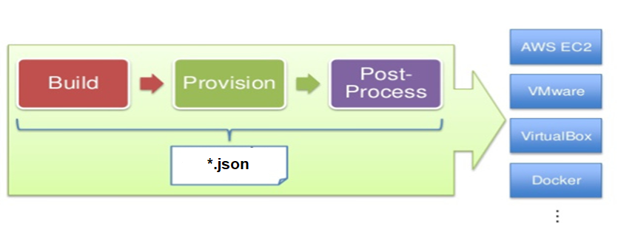
Packer Workflow
OCI Images

Slide 5
Packer details
{
"variables": {
"aws_access_key": "aws_access_key”,
"aws_secret_key": "aws_secret_key"
},
"builders": [{
}],
"provisioners": [
],
"post-processors": ["vagrant"]
}
*.json

Slide 6
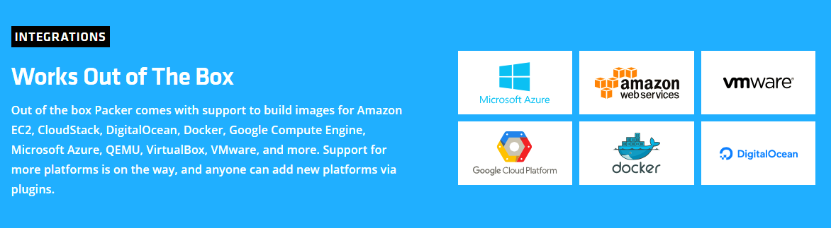
Packer Integration

Slide 7
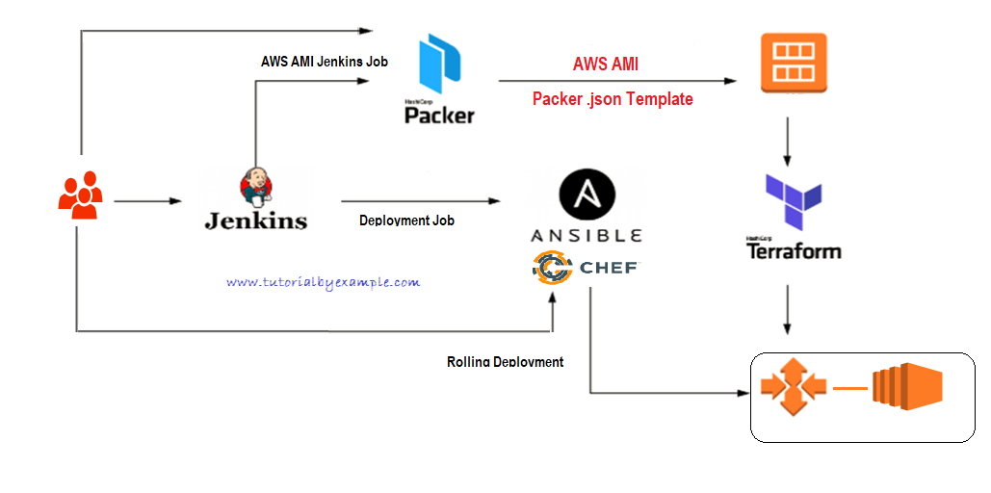
Packer with other tools

Slide 8
INFRASTRUCTURE AS CODE
Modern, Automated
HashiCorp Packer is easy to use and automates the creation of any type of machine image. It embraces modern configuration management by encouraging you to use automated scripts to install and configure the software within your Packer-made images. Packer brings machine images into the modern age, unlocking untapped potential and opening new opportunities.

Slide 9
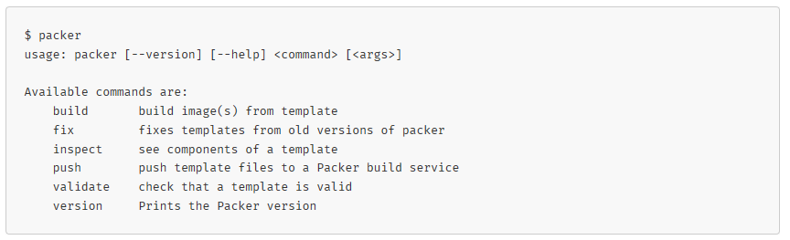
Packer installation verification

Slide 10
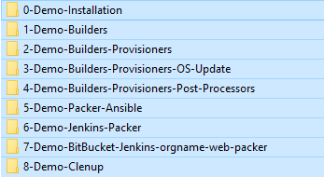
Demos in AWS
Notes:
Demo

Slide 11
Conclusions
End of this course you will able to understand
How to install Packer in Windows/Unix?
Understand packer.json file (templates)
How to use builders?
How to use provisioners?
How to user post-processors?
Calling other script. E.g. Ansible or other inside packer
Jenkins Packer Integration
Packer with AWS, creating new images (AMI), installing few Software's
All with done in Unix like Operating System

Slide 12
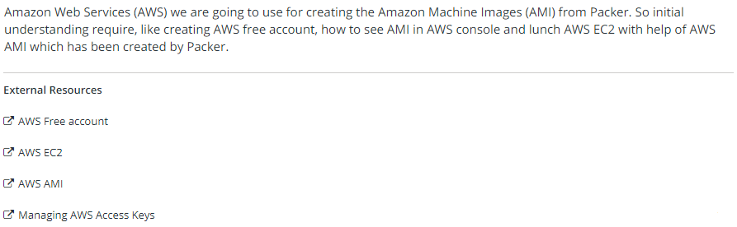
AWS & Packer

